Slide 1
Welcome!
feel free to tweet
#EVOCAGM2015
#welfarereform

Slide 2

The plan…
Introduction – Laura Plumb (EVOC)
The Scotland Bill – Allan Young, Scottish Council for Voluntary Organisations
Welfare Reform and Work Bill – Jon Shaw, Child Poverty Action Group
Questions and Discussion

Slide 3
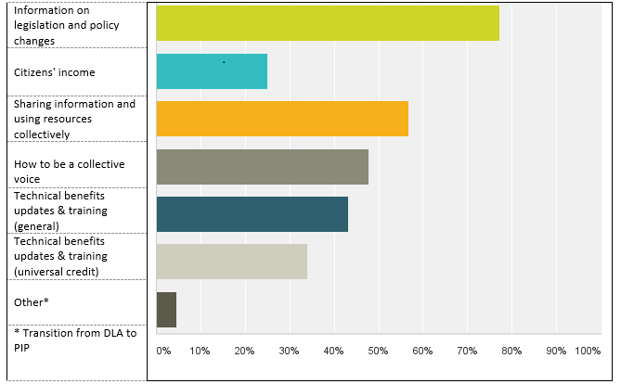
Welfare reform survey
Many thanks for doing that

Slide 4


Slide 5
Scotland Bill
Allan Young
Welfare Engagement Officer

Slide 6
Where we are now
Amendments: carers definition victory
House of Commons
House of Lords
Scottish Parliament Committees
Fiscal framework and ‘no detriment’

Slide 7
New Powers
£2.6bn Social Security spending
Income tax bands and rates
Management of Crown Estate
Operation of Scottish Parliament
Removable taxes, e.g. air passenger duty
Road signs, onshore oil and gas extraction

Slide 8
New Social Security Powers
Disability and carers benefits
Discretionary Payments
Powers over Universal Credit
Employability Programmes
Regulated Social Fund
Welfare Foods

Slide 9
Risks
Localisation: England example
Administration errors – CPAG evidence
Infrastructure

Slide 10
Opportunities for Change
Improve value of social security support
Increase levels and ‘top ups’
Improve operation of system
Support Individuals
Simplify system
Enhance communication and ‘journey’
Reduce risk of sanctions
Notes:
“no detriment” clause which would give the UK the right to claw back monies if variations in expenditure in Scotland were deemed to be detrimental to the UK budget

Slide 11
Allan Young
Welfare Reform Engagement Officer
0141 559 5017 allan.young@scvo.org.uk
To sign up to the fortnightly Welfare Cuts e-bulletin contact:

Slide 12
PLANNED UK GOVERNMENT WELFARE REFORMS
Jon Shaw
November 2015

Slide 13
BENEFIT RATES FROZEN FOR FOUR YEARS
Includes:
  personal allowances of means-tested benefits and child benefit
  work-related activity component
  all tax credits elements except disability elements
Universal credit affected too (including lower rate of disabled child addition)
Families lose £312 by 2020 (in addition to the effect of previous uprating cuts)

Slide 14
BENEFIT CAP REDUCED
Lowered to:
  £13,400 for single claimants
  £20,000 for couples and families
No longer relates to average earnings
May interfere with the Scottish Government’s ability to vary the amount of universal credit paid for rent
Lone parent of three children on universal credit (no other income) limited to £560 a month towards the rent (3 bedroom LHA rate in Lothian is over £800 a month)

Slide 15
LIMITS ON NUMBER OF CHILDREN
From April 2017 limits support through universal credit or child tax credit to two children and amount for first child lower
Exception if already entitled to UC or CTC (although no extra amounts for further children)
Extra amounts for disabled children still paid
Exceptions may be set out in regulations – example given of multiple births (may be others)
A lone parent with two young children is willing to take on care of his niece and nephew as a kinship carer. May receive no additional financial support from means-tested benefits.

Slide 16
WORK-RELATED ACTIVITY COMPONENT ABOLISHED
From April 2017, new claimants of ESA or UC will not get a ‘work-related activity component’ - benefit reduced to JSA level
No effect on existing ESA/UC claimants
Most ESA claimants £29.05 a week worse off

Slide 17
SUPPORT FOR MORTGAGE INTEREST BECOMES A LOAN
From April 2018, amounts of benefit for mortgage interest become a loan
Loans will be optional and claimants required to get financial advice before taking a loan
May be similar rules to current system in relation to:
  Waiting periods
  Capital limits
  Eligible loans
Owner-occupiers on means-tested benefits lose up to £120 a week

Slide 18
CONDITIONALITY EXTENDED
From April 2017, lone parents of 3-4 year-old children must look for work
Lone parents of 2 year-old children must ‘prepare for work’
Linked to extension of free childcare places (in England)
Risk of Scottish parents being forced to seek work without adequate and affordable childcare arrangements in place

Slide 19
CHILD POVERTY ‘ERADICATED’
Repeal of the duty to:
  report on
  create a strategy to tackle
  reduce
  child poverty
Replaced by measures of full employment and educational attainment
Scottish Government considering setting its own targets/duties

Slide 20
OTHER CHANGES
Universal credit work allowances reduced/removed (April 2016)
Sweeping cuts to tax credits (April 2016? - stalled by the House of Lords)
Waiting period for support with mortgage interest increases to 39 weeks (April 2016)
Reduction of housing benefit backdating to 4 weeks (April 2016)
Restrictions to universal credit amounts for rent to 18-21 year olds (April 2017)
‘Youth obligation’ for claimants aged 18-21 on universal credit (April 2017)

Slide 21

CPAG IN SCOTLAND

Slide 22
ANY QUESTIONS?

Slide 24
THANK YOU

