Slide 1

Delivering the
Citizens and Localities Services Project
Locality Transformation Plan
Citizens and Localities Services Project Team

Slide 2
Section 1 – Background

Slide 3
Financial Savings + Council Transformation Savings
Transformation Programme 16/17/18
Budget proposals / service prioritisation
£126m shortfall
c£31m savings targeted
c£73m savings targeted
BSS including Channel Shift
£19m
CLS
£44m
Range of proposals put forward at F&R 24 Sept 2015
£22m approved in 2015/16 budget
Third Party Payments £4m
Asset Management £6m
Budget consultation Oct – Dec 2015
Budget decision in Jan / Feb 2016
Reduction of c2,000 roles

Slide 4
The Rationale for Locality Transformation
Current service delivery model creates:
additional costs
unnecessary bureaucracy
ultimately poor outcomes for citizens and communities, especially those with complex needs.
Future service delivery model needs to focus on:
Christie Commission
Total Place
Change Funds
Public Bodies (Joint Working) (Scotland) Act 2015
Community Empowerment (Scotland) Act 2015
Neighbourhood Partnerships + Local partnership initiatives
Integrated local services
Empowering employees, citizens, communities and partners

Slide 5
Section 2 – Objectives and Deliverables

Slide 6
Summary of Objectives and Deliverables
STRATEGIC OBJECTIVES
Empower citizens and communities and improve partnership working
Implement a lean and agile locality operating model
Deliver better outcomes and improved citizen experiences
Embedded values and develop culture
asset transfer
locality leadership teams
community participation requests
neighbourhood partnership
participatory budgeting
co-production
locality operating model
integrated HSC and children’s services
13 organisational reviews to release £42m savings
activity analysis
locally integrated and co-located service teams
Improved insight
Locality Improvement Plans
community and family resilience
prevention based projects
public health, and tackling poverty and inequality
Instil good values and behaviours
Locality Learning and Development Plan
engagement and communications with staff and partners
devolved decision making
culture of innovation

Slide 7
Strategic Objective 1:
Empower citizens and communities and improve partnership working

Slide 8
Empowering Citizens and Communities
Total Place Projects
Community Learning and Development Services and Strategy
Third Sector Forums and Partnerships
Volunteering Strategy
Tenants and Residents Groups and the TRA Federation
School Parent and Pupil Councils
Cooperative Capital Framework and cooperatives
Co Produced Commissioning Plans and Grant Programmes
Personalisation and Self Directed Support
Neighbourhood Partnerships
Community Council
Community Engagement Standards

Slide 9
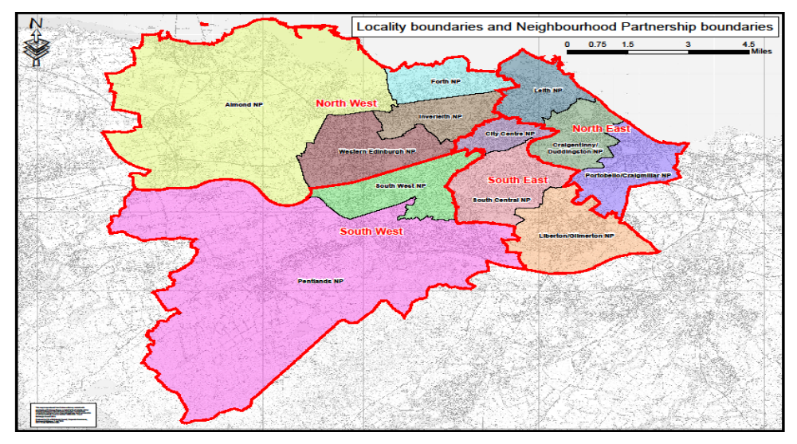
Co-terminus Locality Operating Areas

Slide 10
Locality Leadership Teams
Locality Leadership Team
Council Executive Director + Senior Community Planning Partner
Council Heads of Service
Representatives from each community planning partner in the locality including Police Scotland, Fire and Rescue Service Scotland, NHS and third sector
Locality Improvement Plans
Notes:
Part 2: Community Planning: Places Community Planning Partnerships (CPPs) on a statutory footing and imposes duties on them around the planning and delivery of local outcomes, and the involvement of community bodies at all stages of community planning. Tackling inequalities will be a specific focus, and CPPs will have to produce “locality plans” at a more local level for areas experiencing particular disadvantage.

Slide 11
Community Empowerment (Scotland) Act 2015
Community Participation Requests
Community Asset Transfer
Community Planning and Community Engagement
Local Outcome improvement Plans and Locality Improvement Plans

Slide 12
Strategic Objective 2:
Implement a lean and agile localities operating model

Slide 13




The City of Edinburgh Council Operating Model
Improve quality of life
Ensure economic vitality
Build excellent places
Deliver lean and agile Council services
Information
(including business intelligence,
analytics and insight)
Customer and Community Contact
Bringing together the first point of contact for our customers, supporting increased use of digital channels, providing first time resolution
Signposting, triage and referrals onwards to services where needed
Localities
Four geographic areas where resources that directly support communities are organised and joined up around the citizen
Values
City-wide
Services where it is not appropriate to split the resource into four localities but where the services provided is ‘shaped’ based on the understanding locality priorities and needs
Business Services
Bringing together all support activity to one consistent service, reducing duplication and allowing more flexibility. As with our customer services, supporting employees to be more independent and ‘self-serve’ and being driven by customer need.

Slide 14
£42M savings from 12 Organisational Reviews
Children Services
Public Protection and Chief Social Work Officer
Schools and Lifelong Learning
Communities and Families Operations
Environment
Housing and Regulatory Services
Planning and Transport
Culture
Economy
IJB - HSC Disability and Transitions
IJB - HSC Mental Health, Substance Misuse and Sexual Health
IJB - HSC Older People, Palliative Care and Dementia
IJB - HSC Public Health, Prevention, Early Intervention, Health Improvement, Access and Emergency Services, Carers

Slide 15
Integrated Multi Disciplinary Teams
Prominent examples currently in operation or development in the City include:
family nurse partnership
total place projects
reablement and intermediate care teams
community improvement partnerships
drug and alcohol hubs
Inclusive Edinburgh
violent offender watch
children’s services management groups
The CLS Project will continue to support these projects and develop new ones, for example:
sports and lifelong learning service
integrated HSC services
Integrated children’s services
environmental and parks services
transport and planning services
culture and economy services

Slide 16
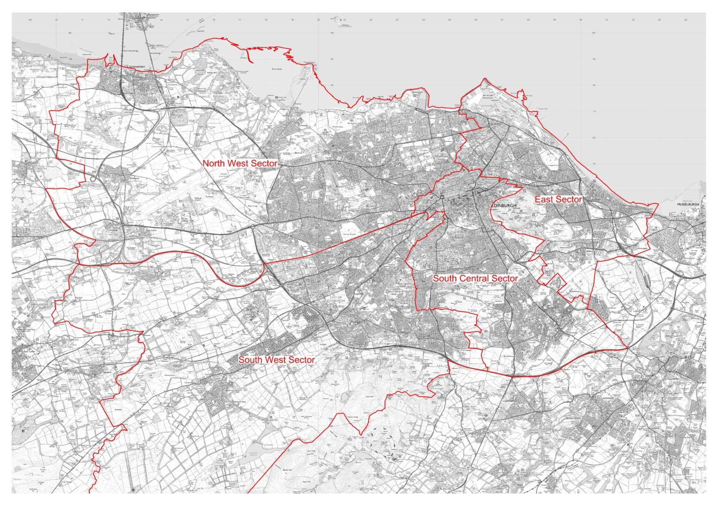
Co-location and Joint Asset Management
Leith
Craigmillar
Muirhouse
Wester Hailes

Slide 17
Strategic Objective 3:
Deliver better outcomes and an improved customer experience

Slide 18
Locality Insight - Key Facts and Challenges
NORTH WEST
NORTH EAST
Larger housing, mature families
Fewer 16-24 year olds
High proportion of empty nesters
Generally affluent, except for Forth ward
Least happy with Edinburgh
Higher rates of deprivation, crime, unemployment, disability / illness
Lower levels of education
Smaller households, Leith and Leith Walk
More social rented, Leith
Leith Walk most diverse ward in city
Largest projected growth to 2024
Additional pressure on primary and secondary schools
Digital literacy, especially for older people in Forth ward
Second largest projected growth to 2024
Highest ratings for broad range of social problems
High renting / low owning mean private property maintenance will be challenging
Regeneration will impact Leith Walk
SOUTH WEST
SOUTH EAST
Most like Edinburgh as a whole
Most deprived individual ward (Sighthill / Gorgie)
High proportion of council tenants
Lower than average proportion of social renters
More than half of the city’s students
Student numbers distort all indicators
Highest private-rented
Low levels of social housing
Most happy with Edinburgh
Most deprived single ward (Sighthill / Gorgie)
Significant levels of localised income inequality
High proportion of economic inactivity due to long term limiting illness
Maintenance of the City Centre key for the city and the Council’s reputation
Pockets of deprivation difficult to detect or address
Continued growth in private rental may effect community cohesion

Slide 19
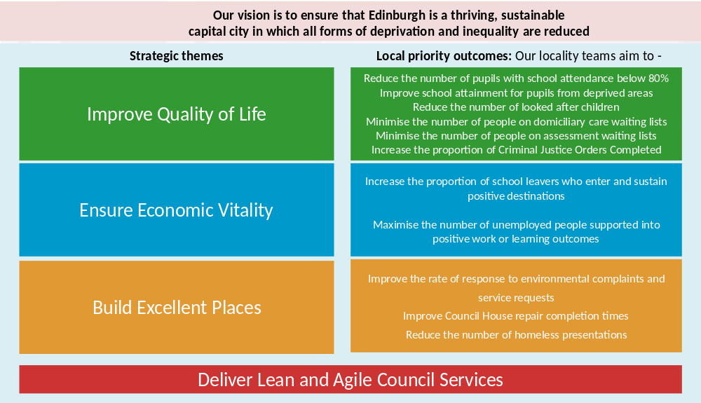
Locality Improvement Plan

Slide 20
Improving Approaches to Prevention
Family Group Conferencing / Group Decision Making
Tertiary
Secondary
Primary
Emergency Homelessness
Drugs and alcohol rehab
Reablement
Family Group Conferencing
Inclusive Edinburgh
Local Outcomes for Older People
BOLD Total Place Project
‘Headroom’ Social Proscribing
Inclusive
Edinburgh
Active and health lifestyles
Domestic Abuse Training
Tackling child poverty
Notes:
The projects identified to date also fall into a further three benefits categories; (a) improving outcomes for citizens with potential LT benefits for the Council and partners (green), (b) shift resources from expensive crisis intervention services to more cost effective preventative services OR directly reduce demand for services, from which savings can be made from demographic pressures budgets (amber), and (c) some will release cashable savings (red).
All of this work will be aligned to the Edinburgh Partnership Prevention Strategic Plan, agreed in June 2015, and sponsored by the Council’s Chief Social Work Officer.

Slide 21
Strategic Objective 4:
Embedding values and developing culture

Slide 22
Embedding Values and Developing Culture
Notes:
Examining the consequences of continuing to work in the current way
Empowering staff and reducing bureaucracy
Analysing the positive and negative aspects of the current culture, and decide what needs to change
Designing the desired ‘culture’ based on the vision, strategy and values of the organisation’s transformation
Helping leaders set the culture through development sessions based around culture building and engagement
Involving influencers at all levels of the Council who are aware of the need to change the current culture
Acknowledge that culture change is an organic process that will take time and will only happen if there is encouragement and role modelling for working in a new way
Leadership group walking the walk and talking the talk
Working collaboratively with citizens and communities to develop resilience and empowering decision making

Slide 23
Section 3 – Benefits

Slide 24


Benefits of the Locality Transformation
The Council is lean and agile and addresses the savings gap
A common geography to facilitate improved partnership working
Simplified customer journeys
Integrated and co-located teams
Improved support for families and individuals with complex needs
Improved insight
Develop resilience and well-being
Co-produce services
Empowered communities, citizens and employees enabled to enhance decision-making at a local level
Improved approaches to prevention and early intervention
Improved outcomes especially for those citizens, families and communities with complex needs, and who experience poverty and inequality.

