Slide 1
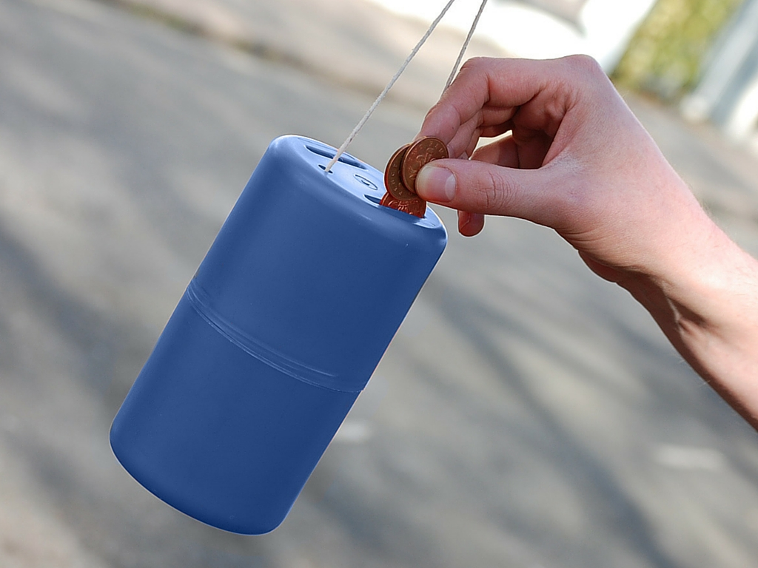

Trustees, Fundraising Regulation
and Recent Changes
Presented by Morag Fleming,
MInstF (Cert)
Trustees, Fundraising Regulation and Recent Changes
Presented by Morag Fleming, MInstF(Cert)
Notes:
Introduce yourself: day job, Institute voluntary role, and any other voluntary roles eg Trusteeships
Then describe aims of the presentation, introduction to
A. fundraising regulation
B. self-regulation & the code of fundraising practice
C introduce the Institute in Scotland
D benefits of membership

Slide 2
Trustees Responsibilities
“Trustees are responsible for taking control of how their charity fundraises.”
OSCR Trustees Duties
Notes:
Start by setting the context: there’s a lot of law and regulation..
The main pieces:
Charities & Trustee Investment (Scotland) Act 2005 established the Scottish Charity Register and OSCR - the Charity Regulator, introduced control of fundraising & a commitment to self-regulation. Requirement to produce annual report/accounts and to make it available to ‘anyone who asks’; requirement to show that you are a Scottish charity on documents etc.
Public charitable collections are still regulated under the 1982 and 1976 Acts, but in 2009 the fundraising regulations were expanded

Slide 3
Laws affecting fundraising in Scotland
Charities and Trustee Investment (Scotland) Act 2005
Charities and Benevolent Fundraising (Scotland) Regulations 2009
Charities References in Documents (Scotland) Regulations 2007
Civic Government (Scotland) Act 1982
Civic Government (Scotland) Act 1976
Public Charitable Collections (Scotland) Regulations 1984 (as amended)
Public Services Reform (Scotland) Act 2010
Notes:
Start by setting the context: there’s a lot of law and regulation..
The main pieces:
Charities & Trustee Investment (Scotland) Act 2005 established the Scottish Charity Register and OSCR - the Charity Regulator, introduced control of fundraising & a commitment to self-regulation. Requirement to produce annual report/accounts and to make it available to ‘anyone who asks’; requirement to show that you are a Scottish charity on documents etc.
Public charitable collections are still regulated under the 1982 and 1976 Acts, but in 2009 the fundraising regulations were expanded

Slide 4

Charity and Benevolent Fundraising (Scotland) Regulations 2009
Professional Fundraiser
Benevolent Fundraiser
Solicitation Statements
Contracts
Declarations
Commercial
Participator
Agreements
Professional Fundraising Organisation
Notes:
Definitions of:
Professional Fundraiser and Professional Fundraising Organisation
Commercial Participator
Benevolent Fundraiser
Requirement for:
Solicitation statements
Agreements
DEclarations

Slide 5

Other UK-wide legislation
Notes:
UK-wide Regulation which also applies to charities operating in Scotland:
Data Protection Act 1998: Privacy and Electronic Communications (EC Directive) Regs 2003 (as amended) ; Consumer Protection (Distance Selling) Regulations 2000; Finance Act 2000; Finance Act 2010; Income Tax Act 2007; The Charitable Deductions (Approved Scheme) Regulations 1986
Health & Safety at Work Act 1974; Health & Safety (First Aid) regulations 1991; Licensing Act 2003
Gambling Act 2005; Food Safety Act 1990; Food Safety (General Food Hygiene) Regulations 1995; The Package Travel, Package Holidays and Package Tours Regulations 1992; The Civil Aviation Air Travel Organisers’ Licensing Regulations 1995

Slide 6
What does OSCR say trustees
should be doing?
2005 Act provides charities and therefore trustees with greater control over those who fundraise for them.
Trustees must therefore be aware of the provisions of the Act and the Codes of Practice that fundraisers work to.
Trustees must ensure that formal agreement is made between the charity and any benevolent body, professional fundraiser or commercial organisation that is involved in raising funds for them.
Trustees have a duty to consider what action to take in the interests of the charity if they become aware of unauthorised fundraising carried out in their name
Notes:
Start by setting the context: there’s a lot of law and regulation..
The main pieces:
Charities & Trustee Investment (Scotland) Act 2005 established the Scottish Charity Register and OSCR - the Charity Regulator, introduced control of fundraising & a commitment to self-regulation. Requirement to produce annual report/accounts and to make it available to ‘anyone who asks’; requirement to show that you are a Scottish charity on documents etc.
Public charitable collections are still regulated under the 1982 and 1976 Acts, but in 2009 the fundraising regulations were expanded

Slide 7



Self Regulation of Fundraising across the UK
There are currently 3 bodies that together regulate fundraising in the UK:
IoF = legislator
Responsible for:
Writing the Code of
Fundraising Practice
FRSB = judiciary
Responsible for:
Adjudicating against the Code
PFRA = face-to-face fundraising
Responsible for:
Face-to-face fundraising space allocation
Notes:
1st defence against bad practice:
Institute is professional membership organisation that writes and updates the Code of Practice in consultation with key regulators and experts including OSCR, Scottish Government, Information Commissioner, and Legal Counsel. All members bound by it.
FRSB allows charities to sign up to use its logo and commit to a standard complaints process. Complaints from the general public can eventually be adjudicated on by the FRSB, against the Code. FRSB has a MoU with both the Charity Commission and OSCR to adjudicate on complaints by the general public on fundraising.
PFRA- works with face to face agencies to ensure compliance with Code through mystery shopping and monitoring and books spaces and times on their behalf to manage time and congestion.

Slide 8
IoF Code of Fundraising Practice
The Code is an online, interactive document supported by detailed guidance and linked to external sources of information.
What does it do?
Provides a guide to the law and best practice in relation to fundraising activity throughout the United Kingdom
Covers a wide range of activities, techniques and income streams eg working with volunteers; working with children; raffles & lotteries; trusts
Gives current guidance and thinking; the Code is reviewed and updated whenever a need is identified

Slide 9
The spirit of the Code
Is summed up in four key values:
Legal
Open
Honest
Respectful
Available at: www.institute-of-fundraising.org.uk/code

Slide 10
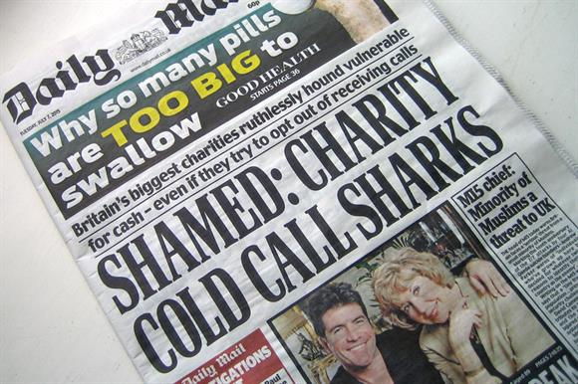
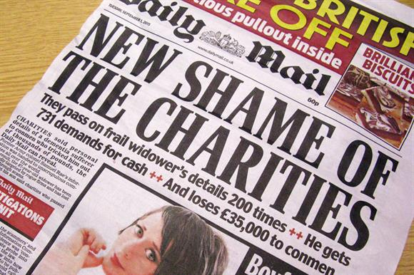
…so what’s happened?
June – Fundraising Standards Board released an
‘interim report’ into their findings from the complaints
they had received following the death of Olive Cooke
with a number of recommendations
June – IoF made some changes to the Code of Practice
Political pressure – “Olive’s law”
BBC One Show and ‘opt out letter’
Undercover investigations:
Telephone fundraising agencies
Data sharing and selling

Slide 11
And Now . . . . .
The whole system of regulation of fundraising is being reviewed
Sir Stuart Etherington review of fundraising self-regulation commissioned by Westminster
SCVO review in Scotland commissioned by Scottish Government

Slide 12
Etherington Review: recommendations
Abolition FRSB – not fit for purpose
Independent Fundraising Regulator (£2 million; 20 FTE)
Universal application, paid for by levy, stronger sanctions
Closer link to Charity Commission, OSCR, NICC
Code of Fundraising to Fundraising Regulator
Fundraising Practice Committee and Complaints Committee
IoF and PFRA merge
Fundraising Preference Service
Move to Opt-in

Slide 13
SCVO review
Trustees to take responsibility for their charities fundraising
Views of the public and donors aren’t sufficiently represented
Sharp increase in concerns expressed about fundraising practices
IoF should take the lead in changing the culture in fundraising
Possibility of a Scottish fundraising regulator being set up . “Scottish based charities overall favour a fully devolved Scottish system whereas cross border charities see UK set up as fine”
Sanctions should be decided by charities themselves and enforced by an “appropriate regulator”
Current self-regulatory is confusing and ineffective
Opt-in membership to the self-regulatory system viewed as problematic

Slide 14
Changes to the Code
Future changes to the IoF Code:
Every addressed fundraising communication will be required to carry a clear message explaining how donors can easily ‘opt-out’ of receiving future communications
Minimum font sizes will be introduced for opt-in and opt-out statement on all printed communication (including newspaper adverts)
Charities will be banned from selling their data for commercial gain
Charities will only be able to share data with other charities if an individual provides express permission and ‘opts-in’ to doing so
Unreasonably persistent approaches; undue pressure; undue intrusion on privacy

Slide 15
What’s happening in Scotland?
On 26th November SCVO are holding a summit –
Protecting Charities and Donors – Designing the Regulation of Fundraising in Scotland
Trustees, CEOs and Fundraisers are invited to attend to put their view on the proposals
Book your place at: http://www.scvo.org.uk/events/protecting-charities-donors-designing-the-regulation-of-fundraising-in-scotland/

Slide 16
The Institute in Scotland
The Professional Membership Body for Fundraisers
550 individual members
Representing 250 organisations
Special Interest Groups:
  Trusts & Foundations
  Individual Giving
  Corporate
  Directors and Heads
  Community FR
5 member-led management and advisory committees
  Executive Committee
  Standards Committee
  Professional Development Ctte
  Membership & Marketing Ctte
  Conference Planning Committee
Leading provider of fundraising training in Scotland
Notes:
Introduce the Institute as it is for you- just a few areas highlighted but add as you see fit
Remember to mention the Scottish conference and the unique opportunity it offers to learn, network (and socialise) with world-class speakers in a comfortable, friendly environment. Opportunities for Bursaries, and opportunities to volunteer are advertisied each year. The Annual Awards celebrate the very best in fundraising – by boht paid staff and volunteers - each year.

Slide 17

Contact Us:
Institute of Fundraising Scotland
Hayweight House, Floor 4, 23 Lauriston Street,
EDINBURGH EH3 9DQ
0131 474 6152
Website: www.institute-of-fundraising.org.uk/scotland
E-mail: scotland@institute-of-fundraising.org.uk
/IoFScotland @IoFScotland
SC038971 in Scotland; Registered Charity No: 1079573 in England & Wales
VAT Registration No: 547 8930 96

