Slide 1




Slide 2

What this workshop aims to do:
Support Third Sector organisations to understand the role of the Edinburgh Compact Partnership
Demonstrate to organisations how their work can contribute to the work of the Partnership

Slide 3
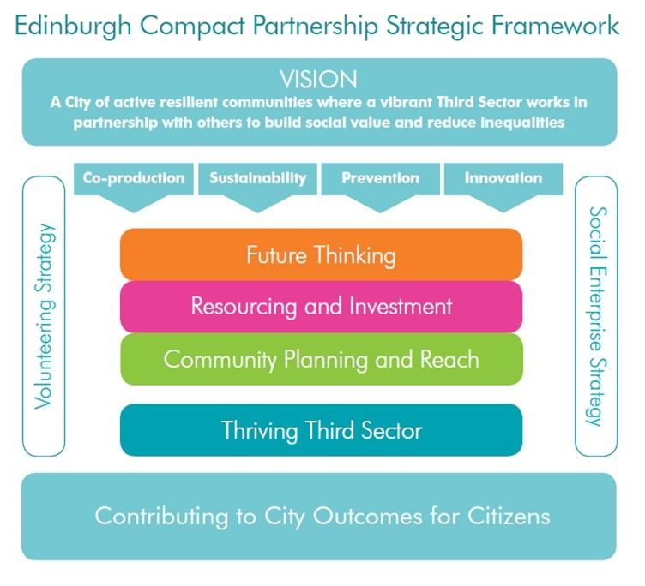

Slide 4
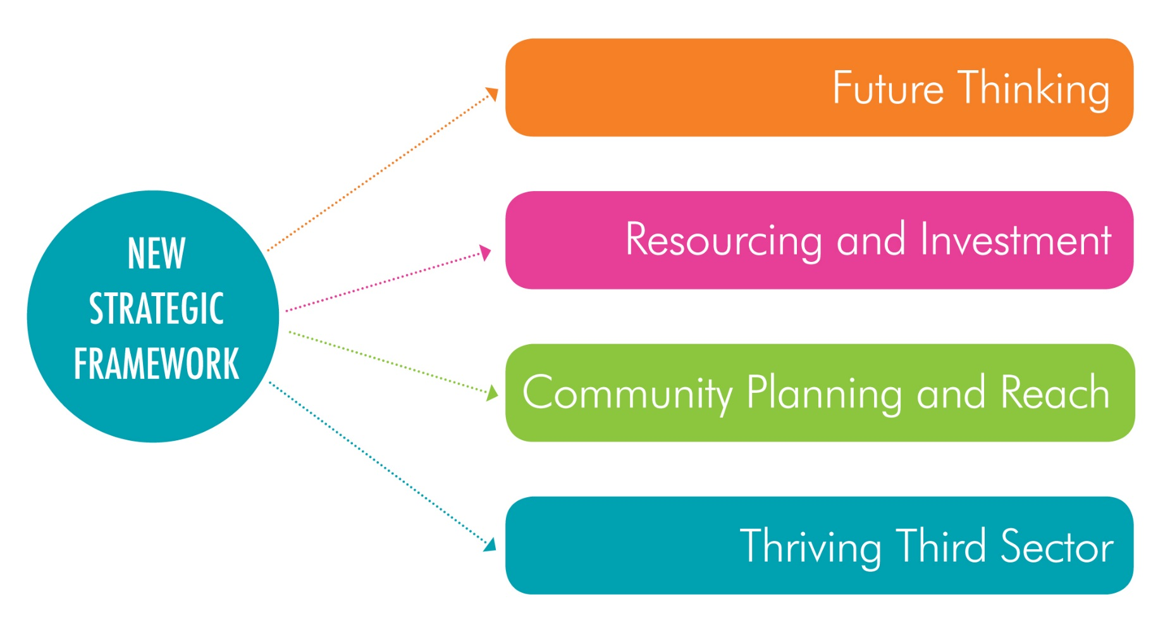
Strands of Working

Slide 5
Third Sector, We NEED You!
Compact needs support from Edinburgh’s vibrant Third Sector in order to achieve the outcomes laid out in the Strategic Framework and Action Plan.
As a Third Sector organisation in Edinburgh, we need you to:
Help shape the services of the future
Take part in making it happen
Make sure we know about your successes
…but what does that actually mean?

Slide 6
Next Steps
Look at what this means and discuss what you can commit to doing

Slide 7
Help Shape the Services of the Future
Tell us:
What changes are needed in public policy, strategy and services
How policy and strategy changes affect your organisation and service users
If there is a better way of doing things
Take part:
In Voluntary Sector Forums and Thematic Networks
In Community Planning and Localities working
In supporting the Police and Fire Service in meeting their community goals
Contribute to:
Compact’s website and newsletter by sharing new ideas and good practice

Slide 8
Take Part in Making it Happen
Take part and stay involved:
In working with partners on developing grants and designing services
In finding the best way of local budgeting and collaborating with colleagues
In the Edinburgh Guarantee, creating the best opportunities for young people
Explore the potential of:
Individual rights, person-centred planning and self-directed support
Making imaginative use of resources, including asset transfer
Private Sector collaboration and corporate social responsibility
Support:
Service users and volunteers to input to planning and design
The living wage

Slide 9
Make sure that we know about your successes
Contribute to:
The Compact Voice survey to ensure we have robust data
The annual Third Sector Forum to share your experiences and influence future development
Challenge:
When you think you can deliver a service better than the Public Sector
Yourself to do the best you can for service users and your community

Slide 10
Many thanks for attending this workshop

